Slide 1

SARCASM DETECTION IN NEWS HEADLINES
By- Priyanshu Sharma
(GROUP-3)

Slide 2
BUSINESS PROBLEM
Detecting sarcasm in news headlines is important to truly understand the sentiment and meaning behind the text.
Misunderstanding sarcasm can result in incorrect sentiment analysis, which can impact business decisions, customer insights, and content moderation.
More accurate sentiment analysis helps businesses better understand customer feelings.

Slide 3
SOLUTION
Proposed Solution:
We developed a CNN-LSTM model to accurately detect sarcasm in news headlines.
This model uses a combination of convolutional and recurrent neural networks to capture patterns and sequences in the text.
Benefits to Business:
Higher accuracy in detecting sarcasm improves sentiment analysis tools.
Real-time sarcasm detection enhances the relevance of curated news content.
Better understanding of customer feedback and public opinion.

Slide 4
DATASET DESCRIPTION
Dataset:
The News Headlines dataset for Sarcasm Detection is collected from two sources: TheOnion (sarcastic) and HuffPost (non-sarcastic).
Dataset Statistics:
Total Records: 26,709
Columns: Headline, Is_Sarcastic, Article_Link
Examples of Text:
" drunk driver in the zone“ (Sarcastic)
" lots of parents know this scenario “ (Non-sarcastic)
" after decades of effort, chemists overseas report 'nano' breakthrough “ (Non-Sarcastic)

Slide 5
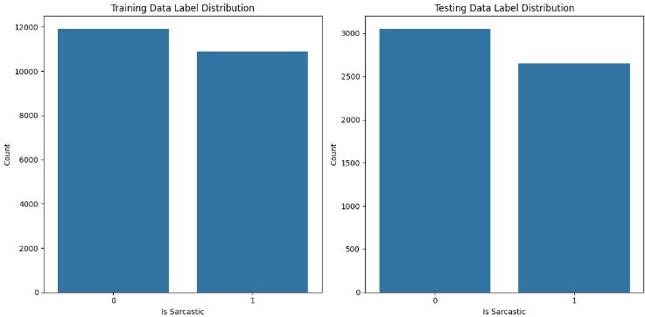
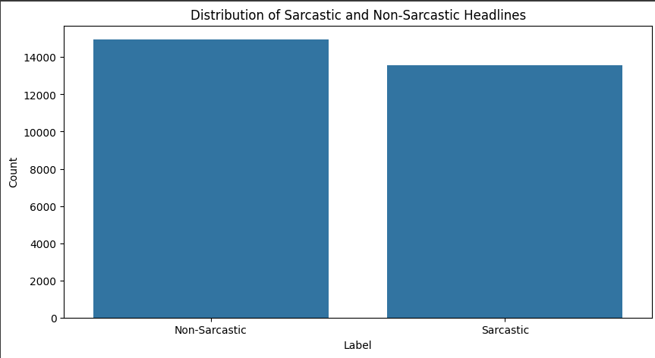
DATA VISUALIZATION
Distribution of Sarcastic and Non-Sarcastic Headlines:
Sarcastic: 47.5% (13,634)
Non-Sarcastic: 52.5% (14,985)
Distribution of Training and Testing Label Distribution:
Training- 22802
Testing- 5701

Slide 6
DATA PREPROCESSING
Steps Taken:
Removed duplicate headlines.
Dropped unnecessary columns (e.g., article links).
Cleaned text by converting to lowercase, removing punctuation, stop words, and non-alphabetic characters.
Techniques Used:
Text denoising through functions to clean and normalize the text.

Slide 7
TOKENIZATION AND EMBEDDING TECHNIQUES
Tokenization:
Converted text to sequences of integers with each integer representing a word in the vocabulary using the Tokenizer from Keras.
Embedding:
Used an Embedding layer in Keras to create dense vector representations of words.
Embedding Dimension: 200

Slide 8
MODELING
Logistic Regression & Naive Bayes: These classical machine learning models were used as benchmarks due to their simplicity and effectiveness in text classification tasks.
LSTM (Long Short-Term Memory): Employed to capture long-term dependencies and sequential patterns in the text data.
CNN (Convolutional Neural Network): Utilized for its ability to extract local features and patterns in text data.
CNN-LSTM: Combined the strengths of CNNs and LSTMs to capture both local features and long-term dependencies, improving the model's ability to detect sarcasm.

Slide 9
MODELING
Model Built:
CNN-LSTM Model:
Combined convolutional layers for feature extraction and LSTM layers for sequential processing.
This model performed well by capturing both local and long-range patterns in the text.
Model Architecture:
Convolutional Layer: Conv1D with 1024 filters and a kernel size of 12.
LSTM Layer: Bidirectional LSTM with 128 units.
Dense Layers: Fully connected layers with Dropout for regularization.

Slide 10
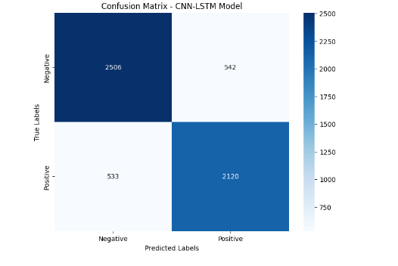
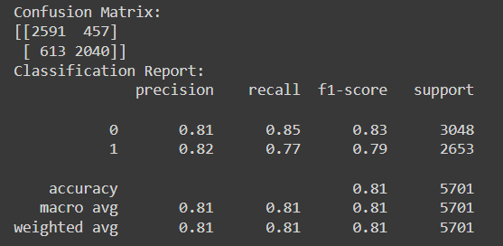
EVALUATION METRICS
Key Metrics:
Accuracy: The percentage of correctly predicted instances.
Confusion Matrix: Breakdown of true positive, false positive, true negative, and false negative predictions.
Classification Report: Precision, recall, and F1-score for each class.
The best score I achieved was with the help of the deep learning model, CNN-LSTM.

